Slide 1

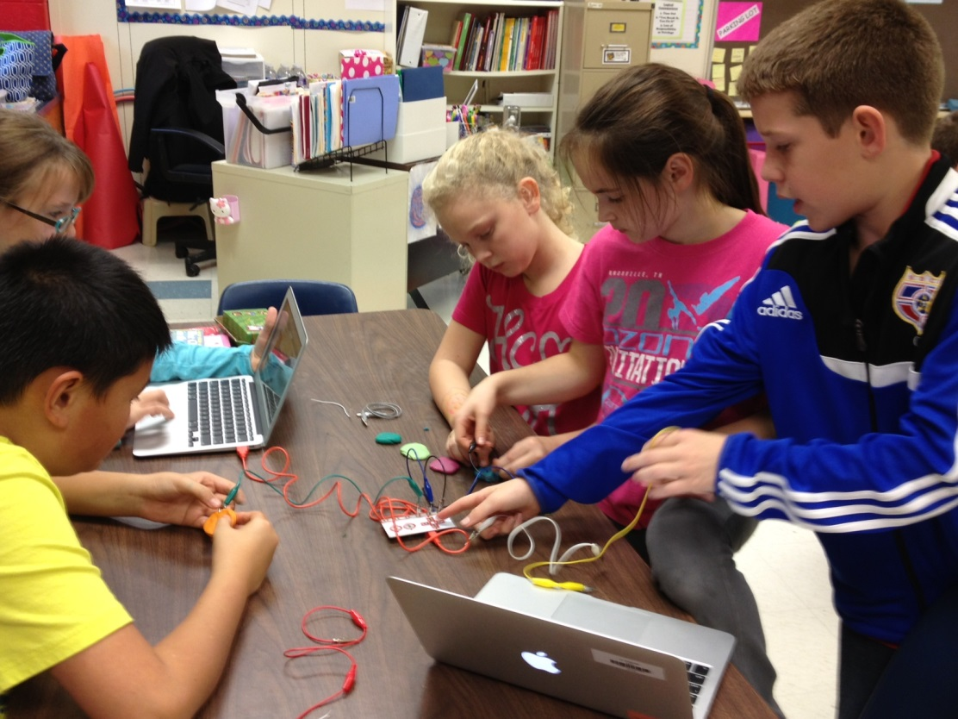
Hollymead Elementary School Improvement Plan
Presented By: Principal Nancy Teel
December 12, 2013

Slide 2
2013-14 Hollymead Improvement Goals
Decrease bullying in the cafeteria and at recess by 10%.
The Spring 2014 Safe School Survey will show 10% fewer students reporting “school is boring.”
Fifth graders will improve Math SOL tests scores by 10% over the next two years.
All Hollymead teachers and administrators will develop and participate in PDSA Media Club and Maker Curriculum/Interactive Technologies.

Slide 3
Why These Goals are Important
A safe learning environment is essential for learning. Students report bullying especially in the cafeteria and at recess.
Rigorous lessons that are interesting to students make school engaging. Thirty percent of 3rd to 5th graders reported school is boring.
Professional development linked to SIP and directed by teachers is effective at promoting Lifelong Learning Skills in students.

Slide 4
Current Challenges
Development of an effective survey on bullying and engagement for kindergarten through fifth grade.
Time and funding for professional development.
Translating professional learning into changes in practice.

Slide 5
Current Successes
Collaboration of art, music, library with second grade for a Native American unit.
Collaboration between library and fifth grade teachers on a light and sound performance task.
Choice for Teachers - ten professional development groups with two to five teachers in each.
Recent school climate surveys suggest a reduction in bullying in the cafeteria.

Slide 6
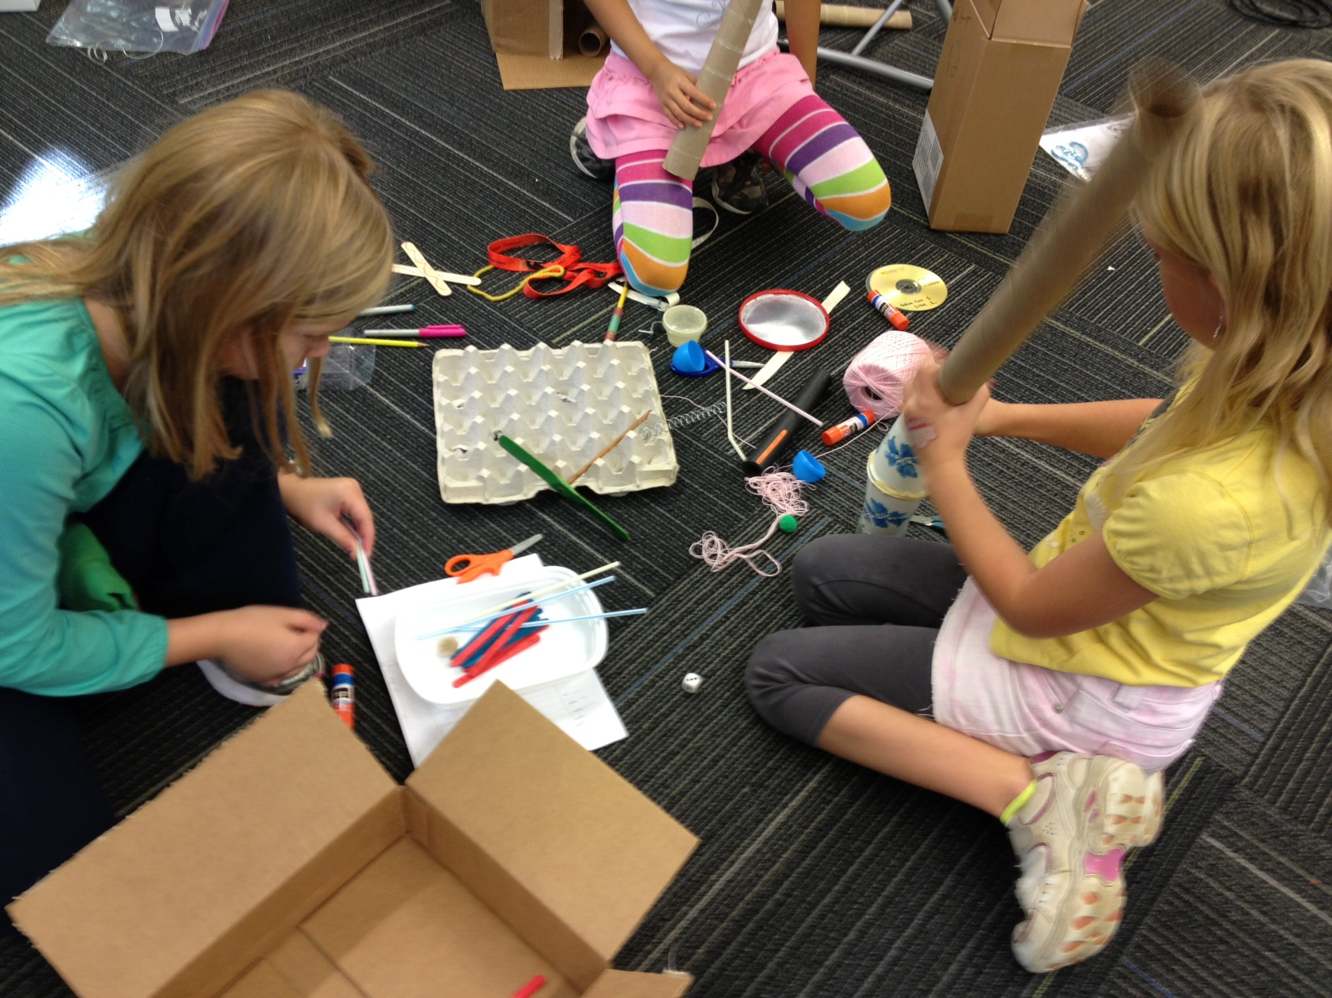
Happy Holidays!

